Slide 1
IBM Advanced Data Scince Capstone
Arabic Sign Language Image Recognition and Classificaition

Slide 2



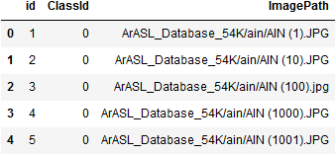
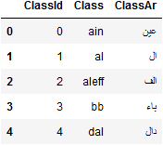
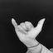
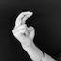




Use Case and Dataset
Use Case
Recognize Arabic Arm Sign Language
build/ Train a Deep Learning Model to recognize/classify images of hand gistures into arabic sign language
Datasets
54k images of arabic sign language categoried into 32 class category
https://www.sciencedirect.com/science/article/pii/S2352340919301283
Mapping Dataset : map images file location and class
Class label Dataset : Arabic and English class label clasification

Slide 3
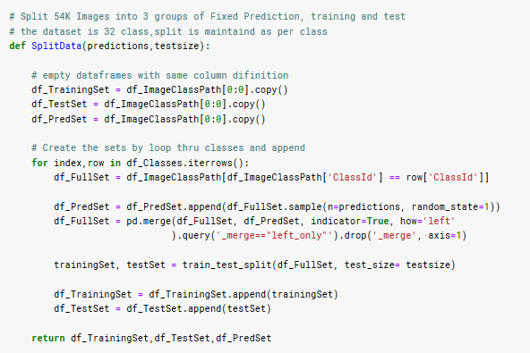
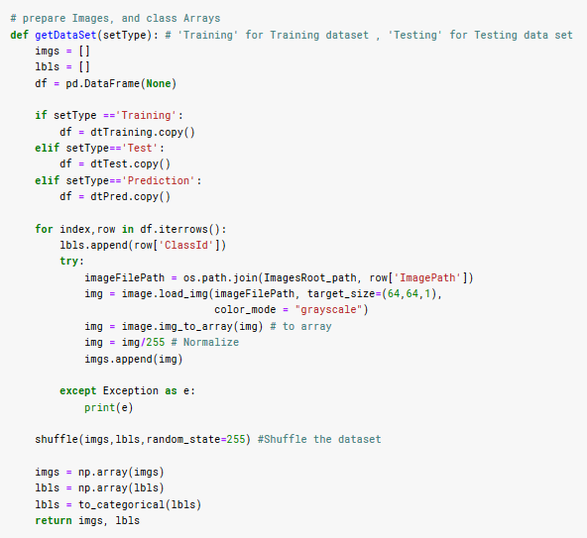
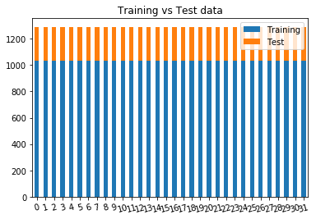
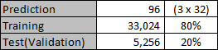
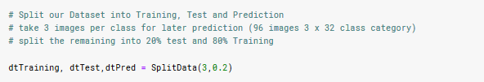
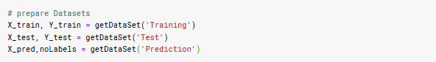
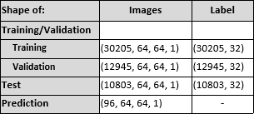
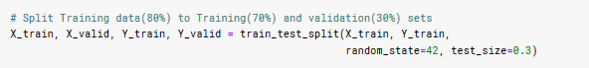
Preparing Datasets
Split Images into (Training, Test(Validation), Prediction)
Resize Images to 64x64, Convert to Grayscale
Convert Images to nparray
Normalize
Convert Class Label (Integer) to Binary class matrix

Slide 4
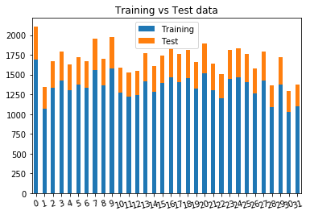
Preparing Datasets
Split Images into (Training and Validation, Test, Prediction)
Resize Images to 64x64, Convert to Grayscale
Convert Images to nparray
Normalize
Convert Class Label (Integer) to Binary class matrix

Slide 5
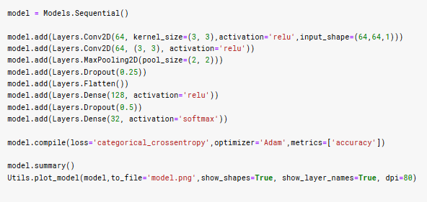
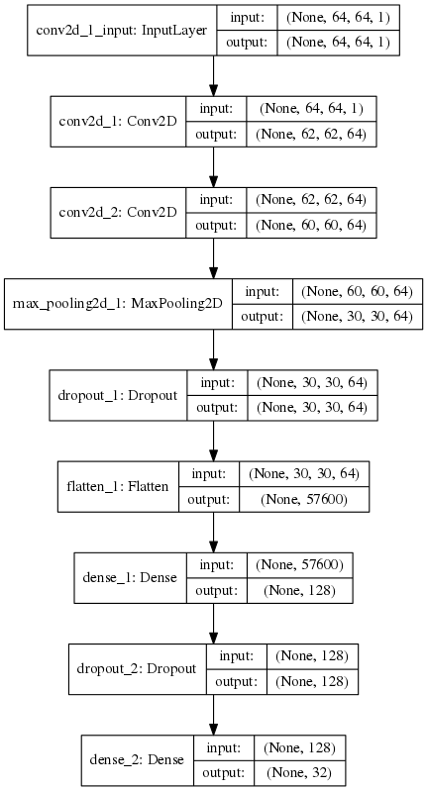
Model Definition
Keras Convolutional Neural Network (CNN)
No# of Epoch : 35 ( with EarlyStopping)
Batch Size: 32 (default)
Optimizer: Adam

Slide 6
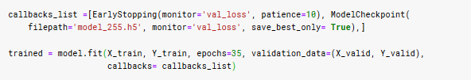
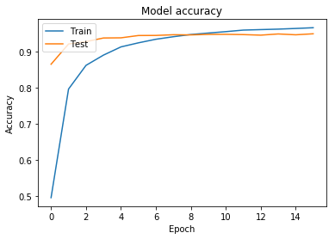
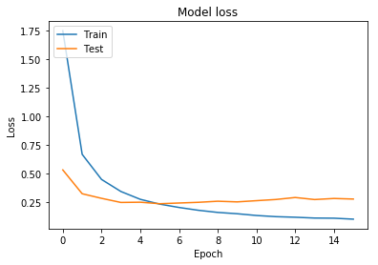
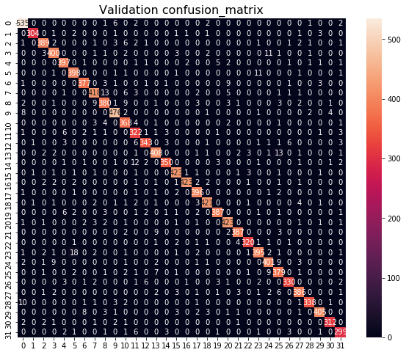
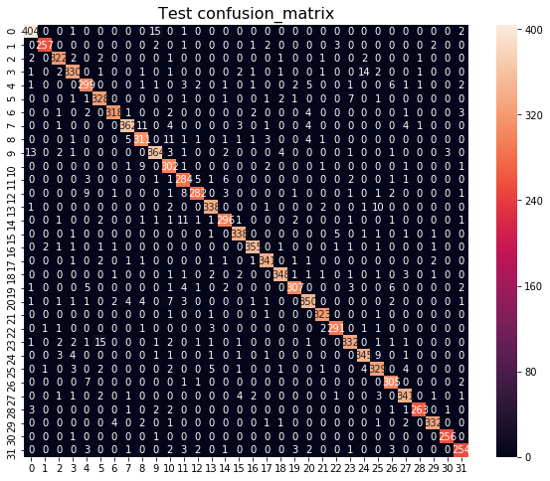
Model Training and Evaluation
Traind on 30205 samples (94.43% Accuracy)
Validate on 12945 samples (94.09% Accuracy)

Slide 7
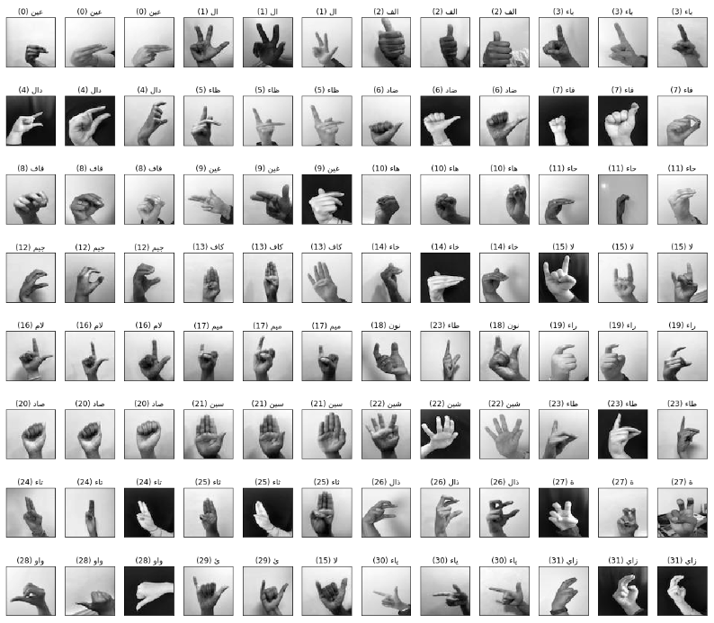
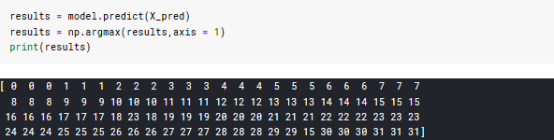
Model Prediction

Slide 8
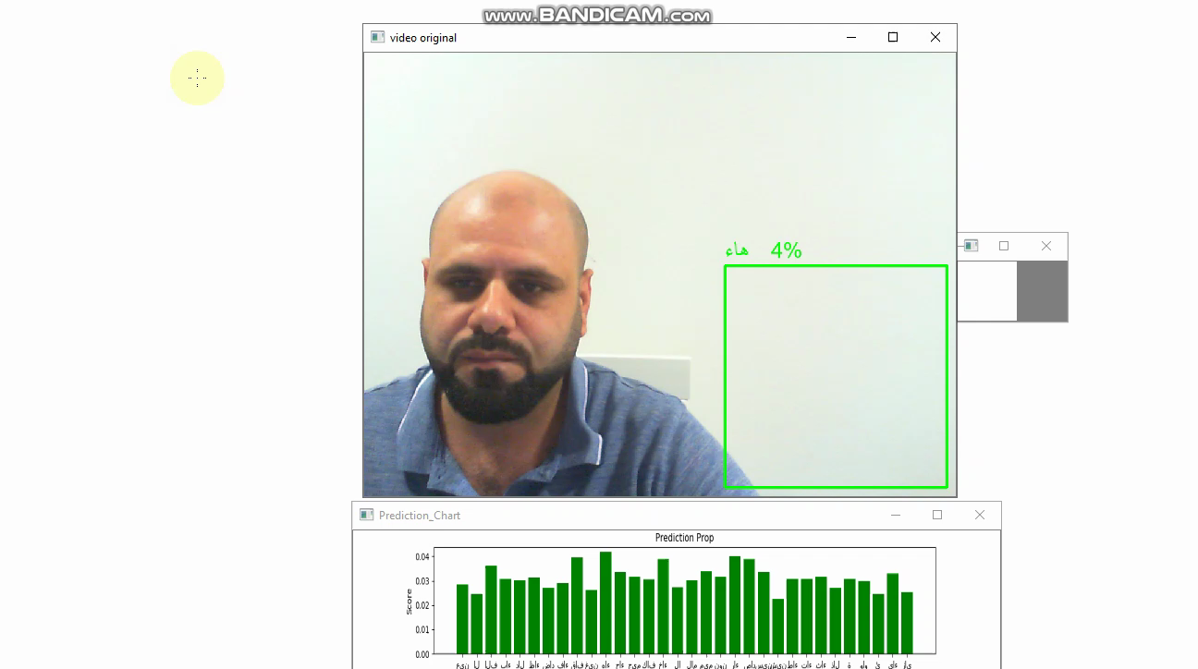
Model Prediction (more...)
Test Model prediction on live stream , Python - OpenCV
Tensorflow, OpenCV, Keras, numpy,Pandas,Matplotlib,.....
Load, Complie Model
Test prediction when image flipped or backgroung changed

Slide 9
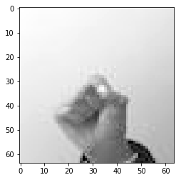
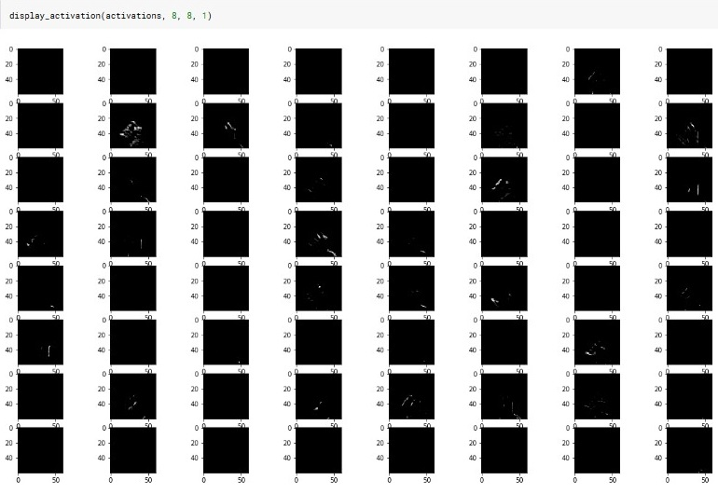
Extra: Visualize CNN Layers

Slide 10
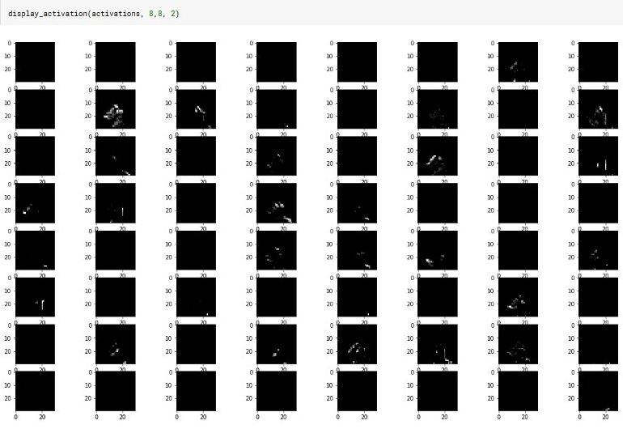
Extra: Visualize CNN Layers

Slide 11
Links
ArASL: Arabic Alphabets Sign Language Dataset (origenal source)
https://www.sciencedirect.com/science/article/pii/S2352340919301283
Arabic Arm Sign Language Image Classification Kaggle Kernal
https://www.kaggle.com/zssash/arabic-sign-language-image-classification
Arabic Arm Sign Language Image Classification Python
https://github.com/ZssAsh/ArASL

Slide 12
Thank you

